Slide 1

Project Sunshine

Slide 2
The Team
Alun Groome
Rachel Chenery
Rana Alqrenawi
Myriam Thursch
Notes:
All
An idea is to link our names with the github profile we’ve developed earlier for the program and have a small nice pic maybe?

Slide 3
Project Sunshine Brief
To develop a web app that can advise on the best time and way to maximise sunshine on your daily walking
Client: Zühlke Manchester
Notes:
ZUHLKE logo on here & sunshine - on every page?
Rachel

Slide 4
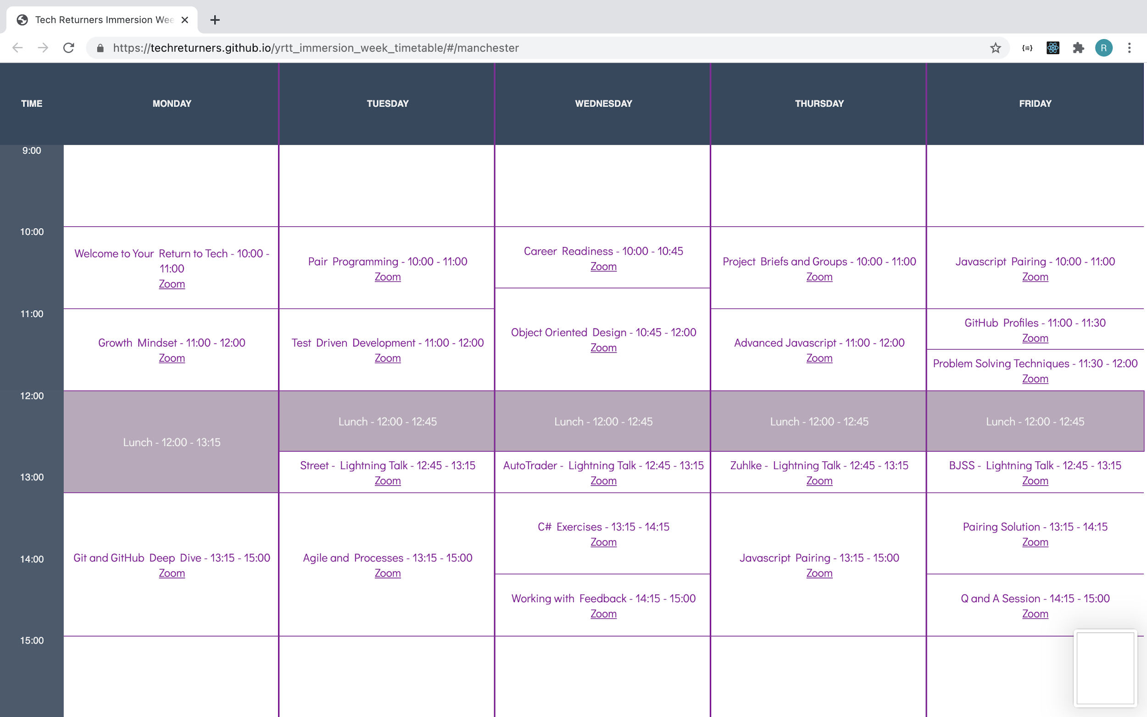
Week 1 - Immersion Week
Notes:
Rachel
Excellent week & preparation for project stage
Sessions on:
working together, communication tips & tools,
how to problem solve,
growth mindset,
working with feedback
Technical:
E.g. frontend design, responsive, accessible
Meeting team & getting project brief

Slide 5
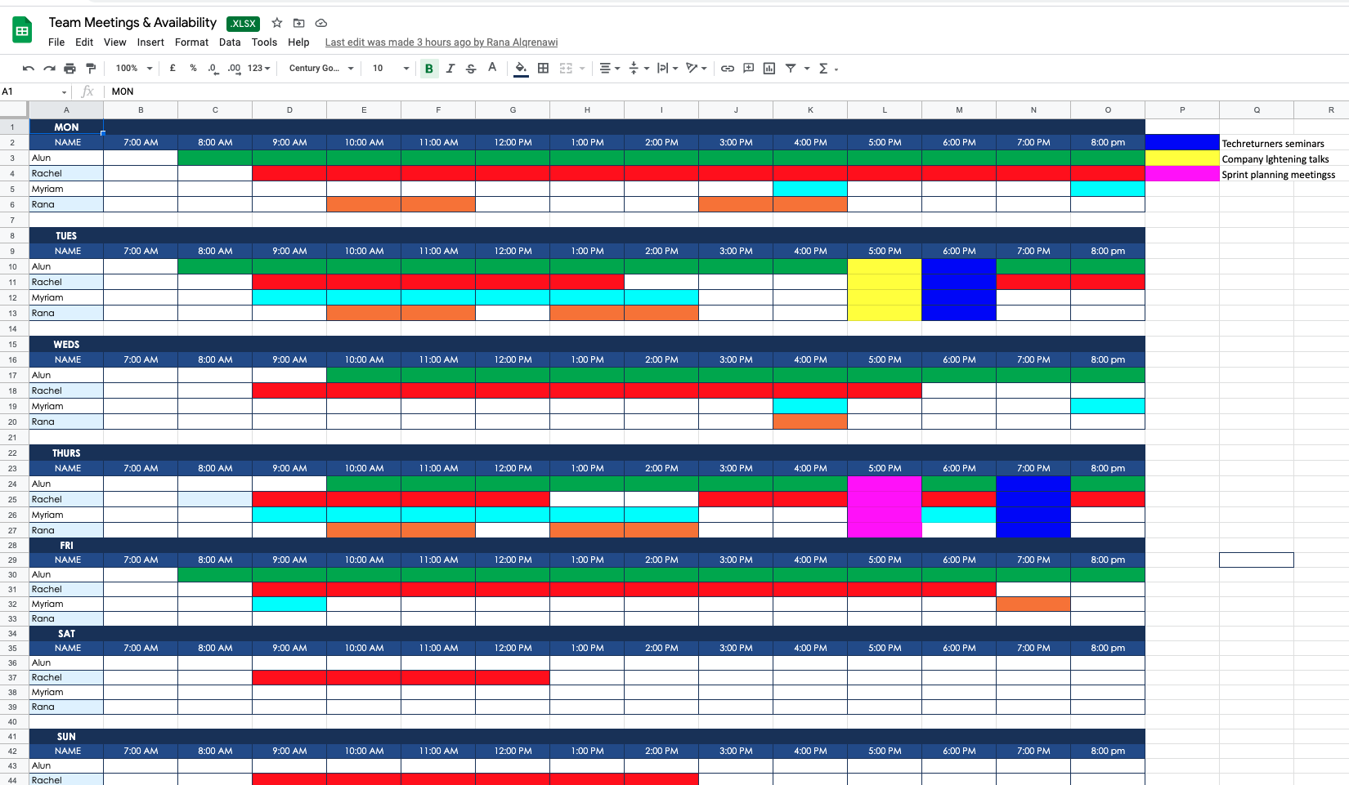
Project Management: Team
Notes:
Rachel
Manage time & work out meeting times considering team availability
Make use of asynchronous communication tools, e.g. Slack
First meeting - didn’t achieve much ‘action points’ but important in terms of working out team cohesion & work styles
Each consequent meeting, starting to gel as a team & strong sense of purpose & cohesion
Share personal profiles with each other - Comment on this??

Slide 6
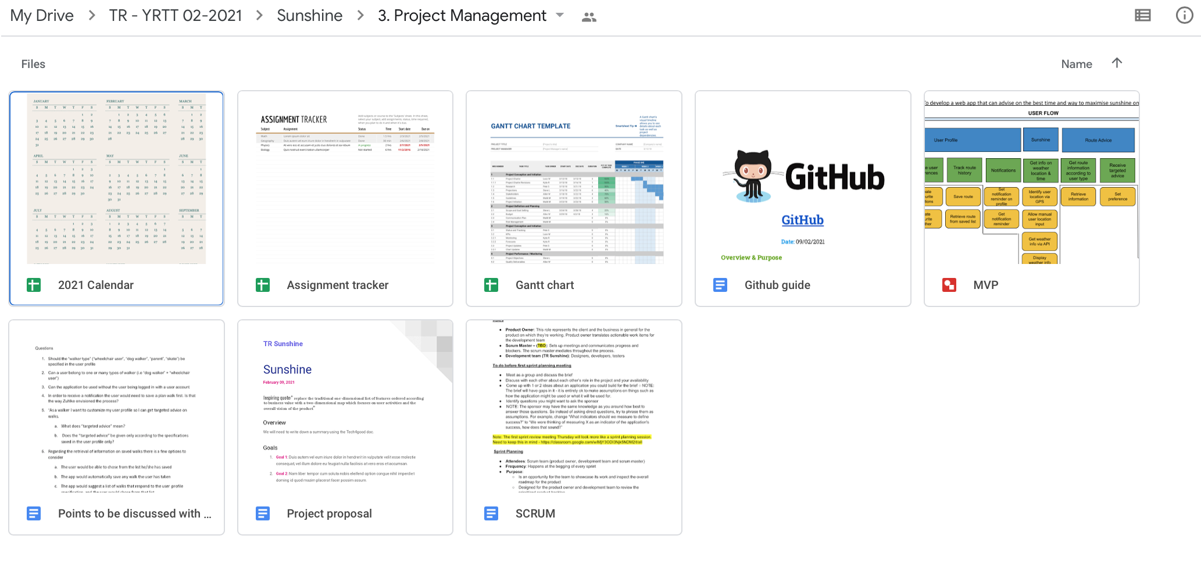
Project Management Methodology: Agile
Notes:
Rana
Agile

Slide 7
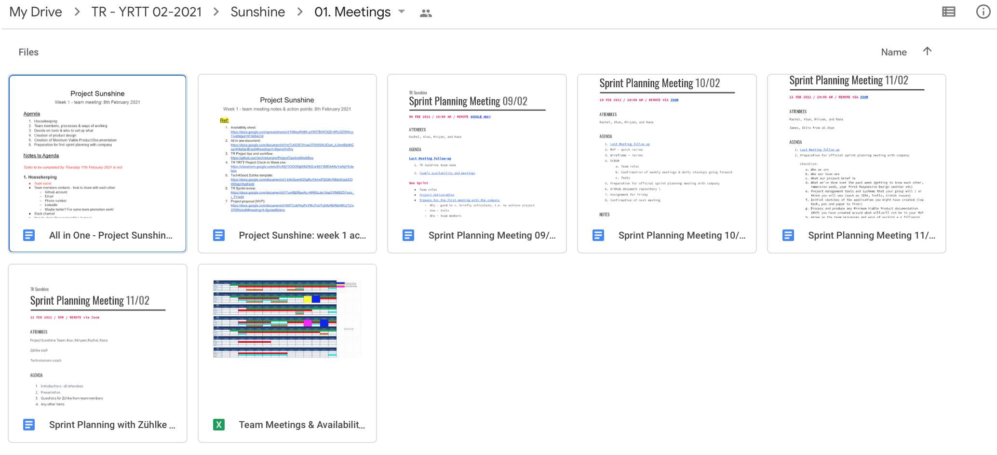
Project Management Approach: Scrum
Notes:
Rana
Kanban v Scrum
Scrum methodology

Slide 8
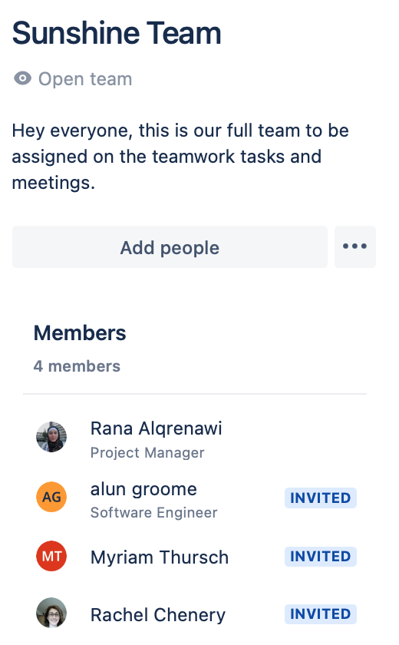
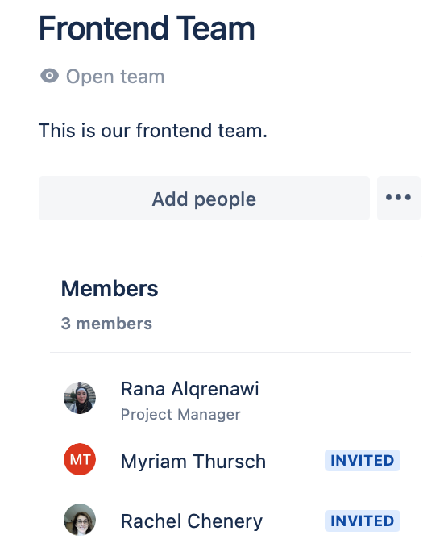
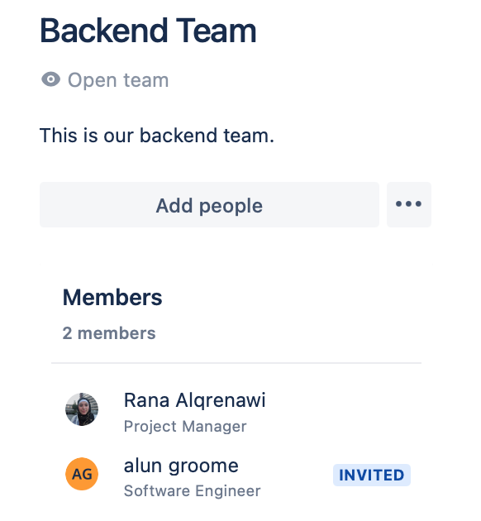
Roles and Accountability
Notes:
Rana
Roles - self - managing team; still forming & will soon consider formal roles
Product Owner
Scrum & Project Management Lead
Agile Team
Frontend Team
Backend Team
Testing team
TDD
Integration testing
Systems Testing

Slide 9
Project Management Tools
Github
Trello vs Jira
Google Drive
Google Meet vs Zoom vs Slack calls
XMind vs Figma vs Google Draw
Notes:
Alun
Documentation - github
Why gira not trello

Slide 10
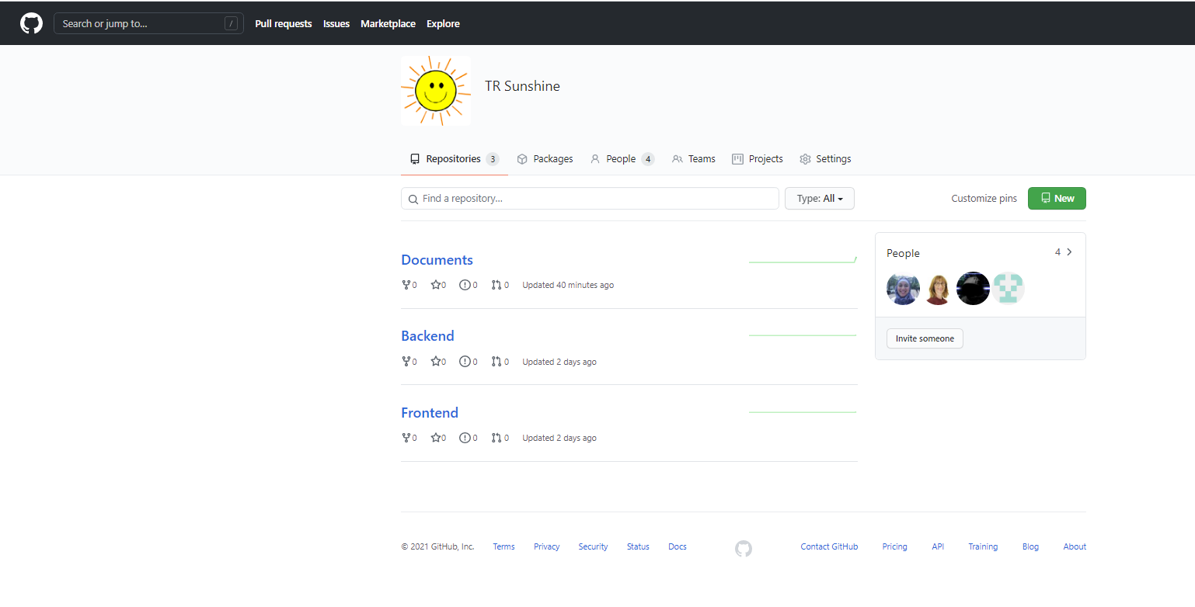
Github Organisation
Notes:
Alun

Slide 11
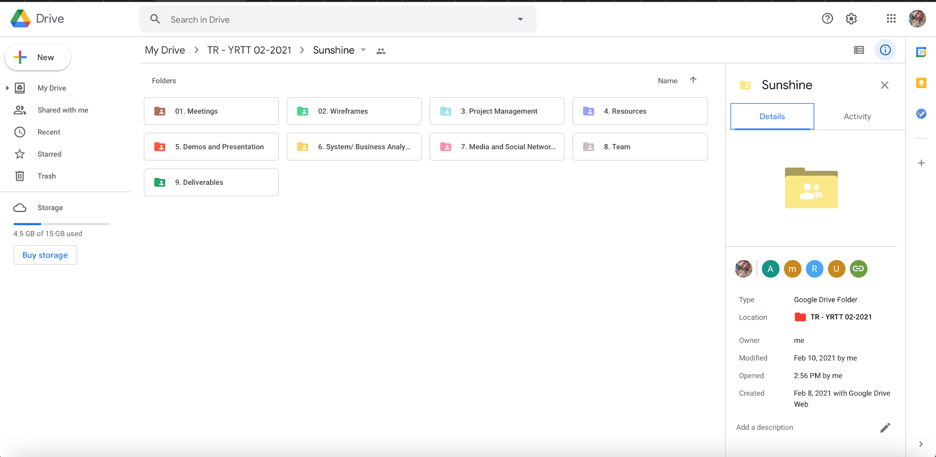
Google Drive
Notes:
Alun

Slide 12
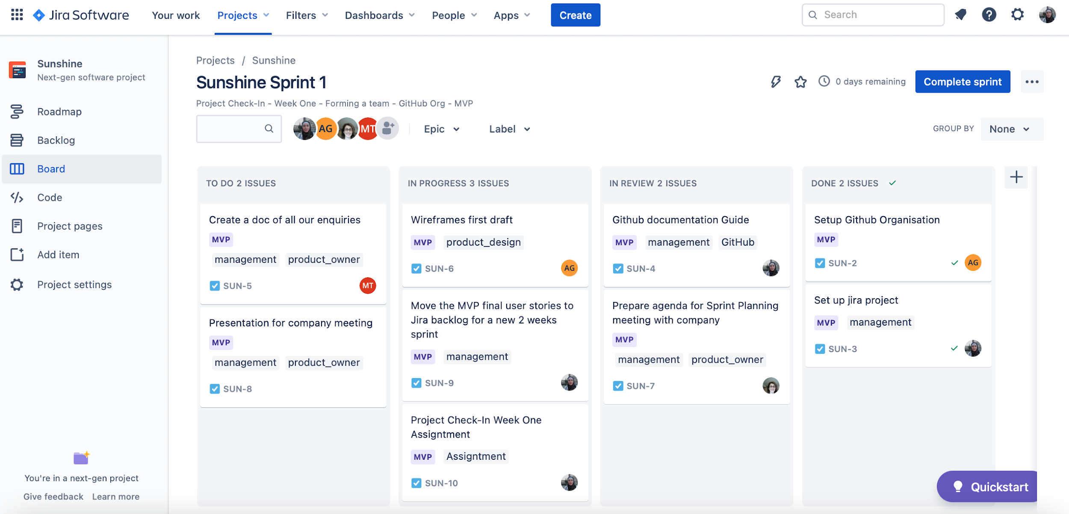
Project Management Tools: Jira
Notes:
Rana
- Sprints, Sprint Planning & Review Meetings, Standups

Slide 13
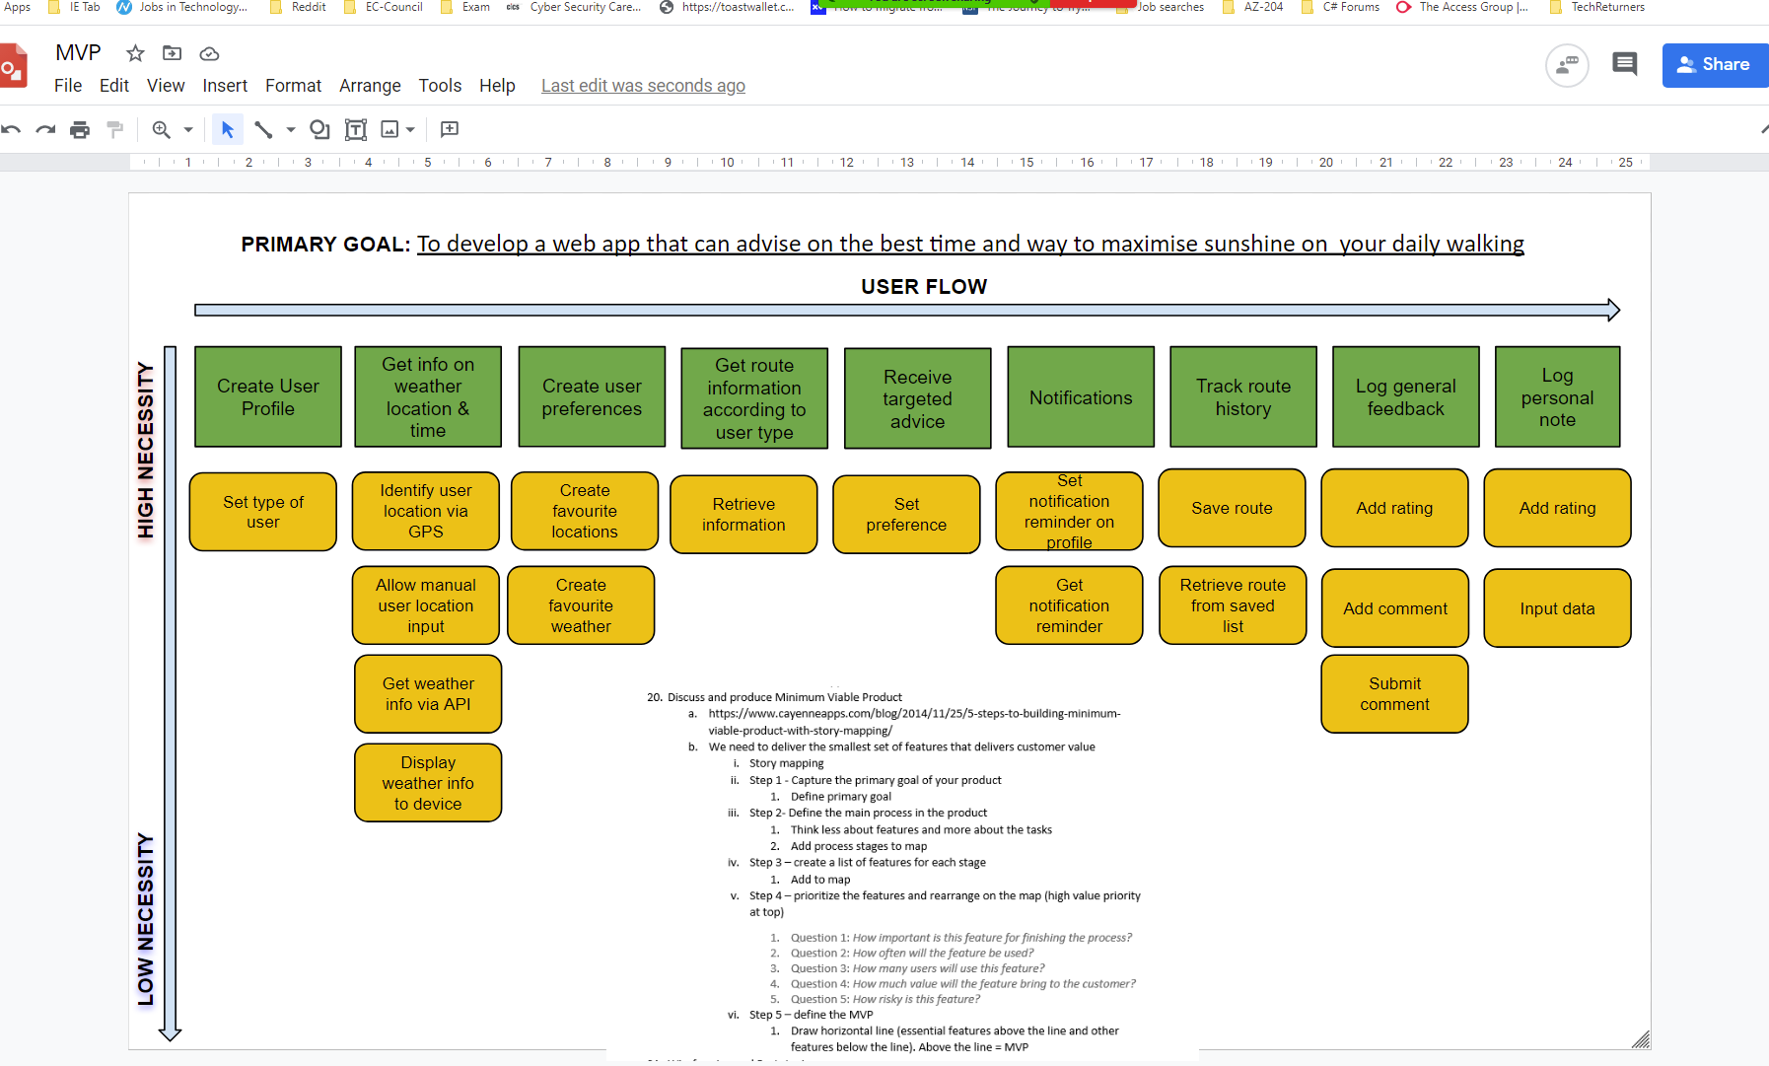
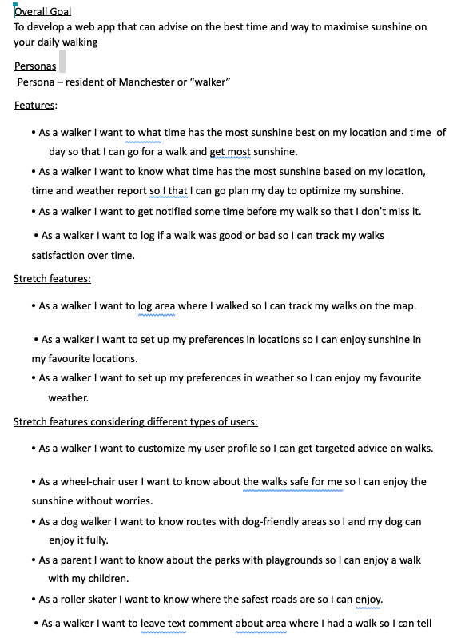
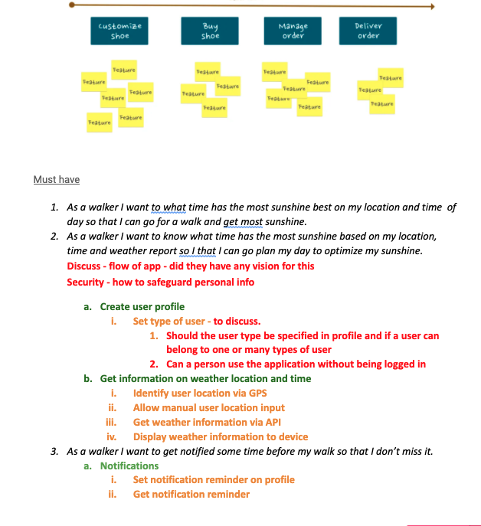
Minimum Viable Product: Process
Notes:
Alun

Slide 14
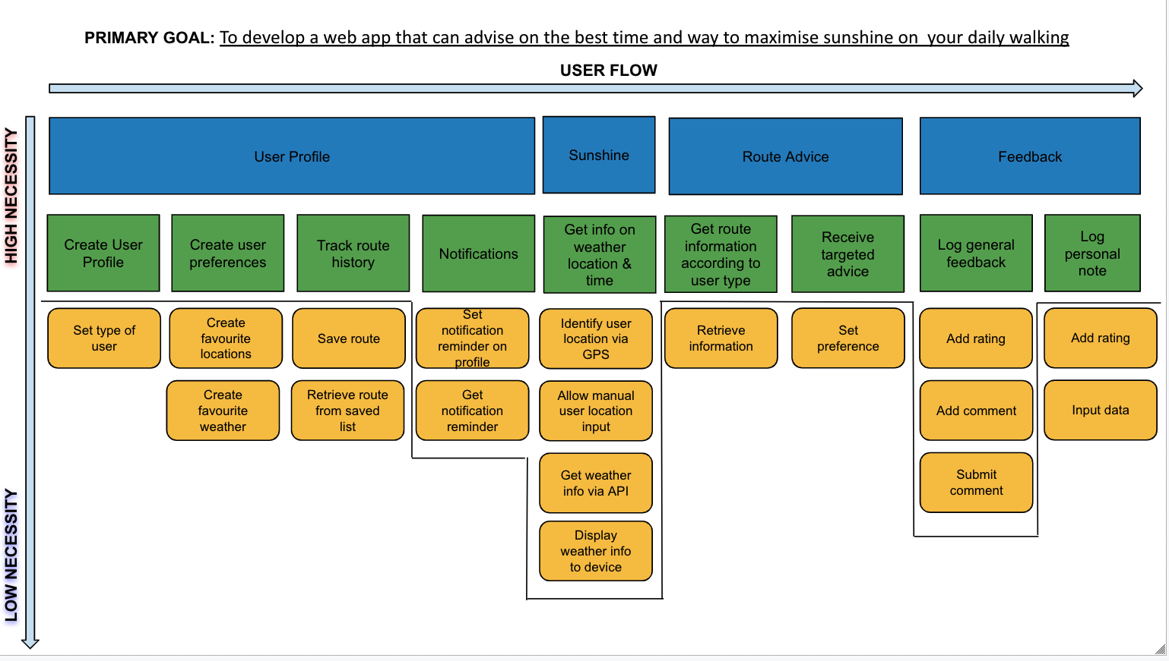
Minimal Viable Product: Current Version
Notes:
Rana

Slide 15
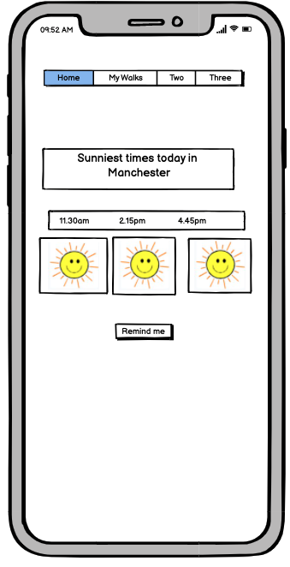
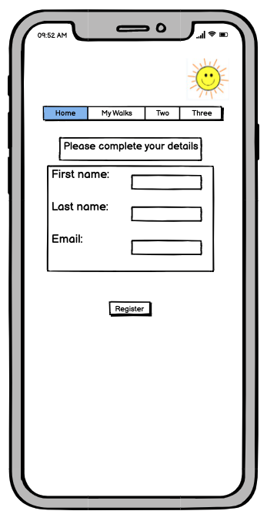
First Wireframe draft
Notes:
Alun & Rachel

Slide 16
Next sprint
Possible wireframe -> prototype
User testing/feedback?
Frontend
Decide on any CSS frameworks
Mood board for colours/look
Colour palette
Responsiveness
Accessibility
React

Slide 17
Points For Discussion
User account (guest)
Persona – resident of Manchester or “walker” (Find user location and/or allow to input)
”targeted advice”
Walk saving and tracking
Weather suggestion for current day
Security
Notes:
Myriam
Based on your brief we have analised that the user would be able to use the App only if an account would have been created and profile preference saved, to enable notification and saving walk history. Does that correspond with how you visualised the product?
In the Brief you describe the persona as “Resident of Manchester- walker”. We suggest the App not to be restricted to Manchester, but to the the devica location, or the user input location. What do think?
We are suggesting to offer the option for the user to save a walk, rather than the App automatically tracking and saving any walk
we have assumed we are displaying weather information for current day and not any other days and ask if that assumption is correct or not
What security considerations do you visualise being implemented in the application

Slide 18
Any questions?

